Slide 1

ANPR & ATCC Smart Traffic Management System
Combining automated number plate recognition and traffic counting to deliver powerful insights for transportation management.

Slide 2
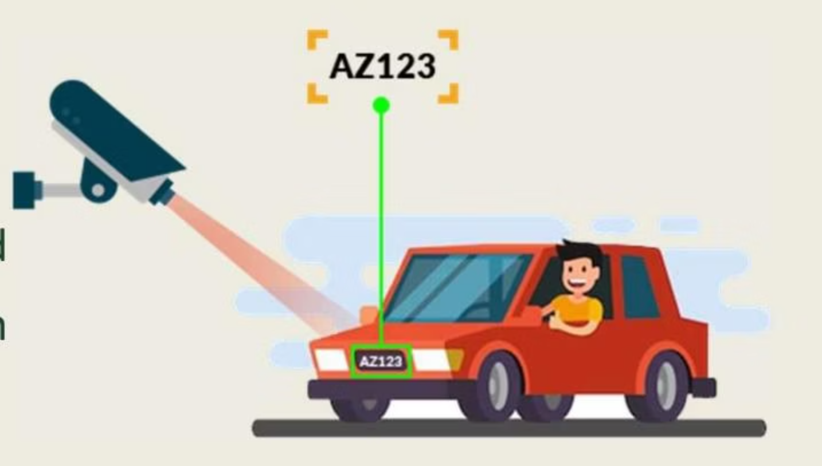
Revolutionizing Urban Mobility
Our system utilizes advanced Deep Learning and Object Detection techniques to automate traffic monitoring and control by recognizing vehicle number plates in real-time and classifying vehicles based on type.
This solution enhances urban mobility, improves traffic efficiency, and supports smarter, safer city infrastructure.

Slide 3


Limitations of Current Traffic Management
Manual Traffic Management
Static Signal Systems
Inefficient during peak hours
Lack adaptability to varying traffic conditions
Prone to human error
Limited to basic traffic data
Less efficient in real-time scenarios
Manual effort for analysis
Technological Gaps
Limited integration of AI-driven solutions
Outdated infrastructure

Slide 4





Automatic Number Plate Recognition (ANPR)
Exploring the applications and benefits of ANPR systems
Purpose of ANPR
Traffic Management
Toll Collection
Detects and extracts license plate information from vehicles in real-time.
Utilized for monitoring and controlling vehicular flow on roads.
Automates toll payments, enhancing efficiency and reducing queues.
Parking Systems
Security Surveillance
Improves parking management through automatic vehicle identification.
Enhances security by tracking vehicles at critical locations.

Slide 5




Vehicle License Plate Recognition Workflow
A structured overview of vehicle plate recognition steps
Input
Detection
System receives input from video feed or static image, initiating recognition process.
YOLO algorithm detects vehicles and isolates their license plates.
Recognition
Storage
EasyOCR technology extracts text from isolated license plates, converting images to text.
All recognized data is organized and saved in CSV format for easy access and analysis.

Slide 6

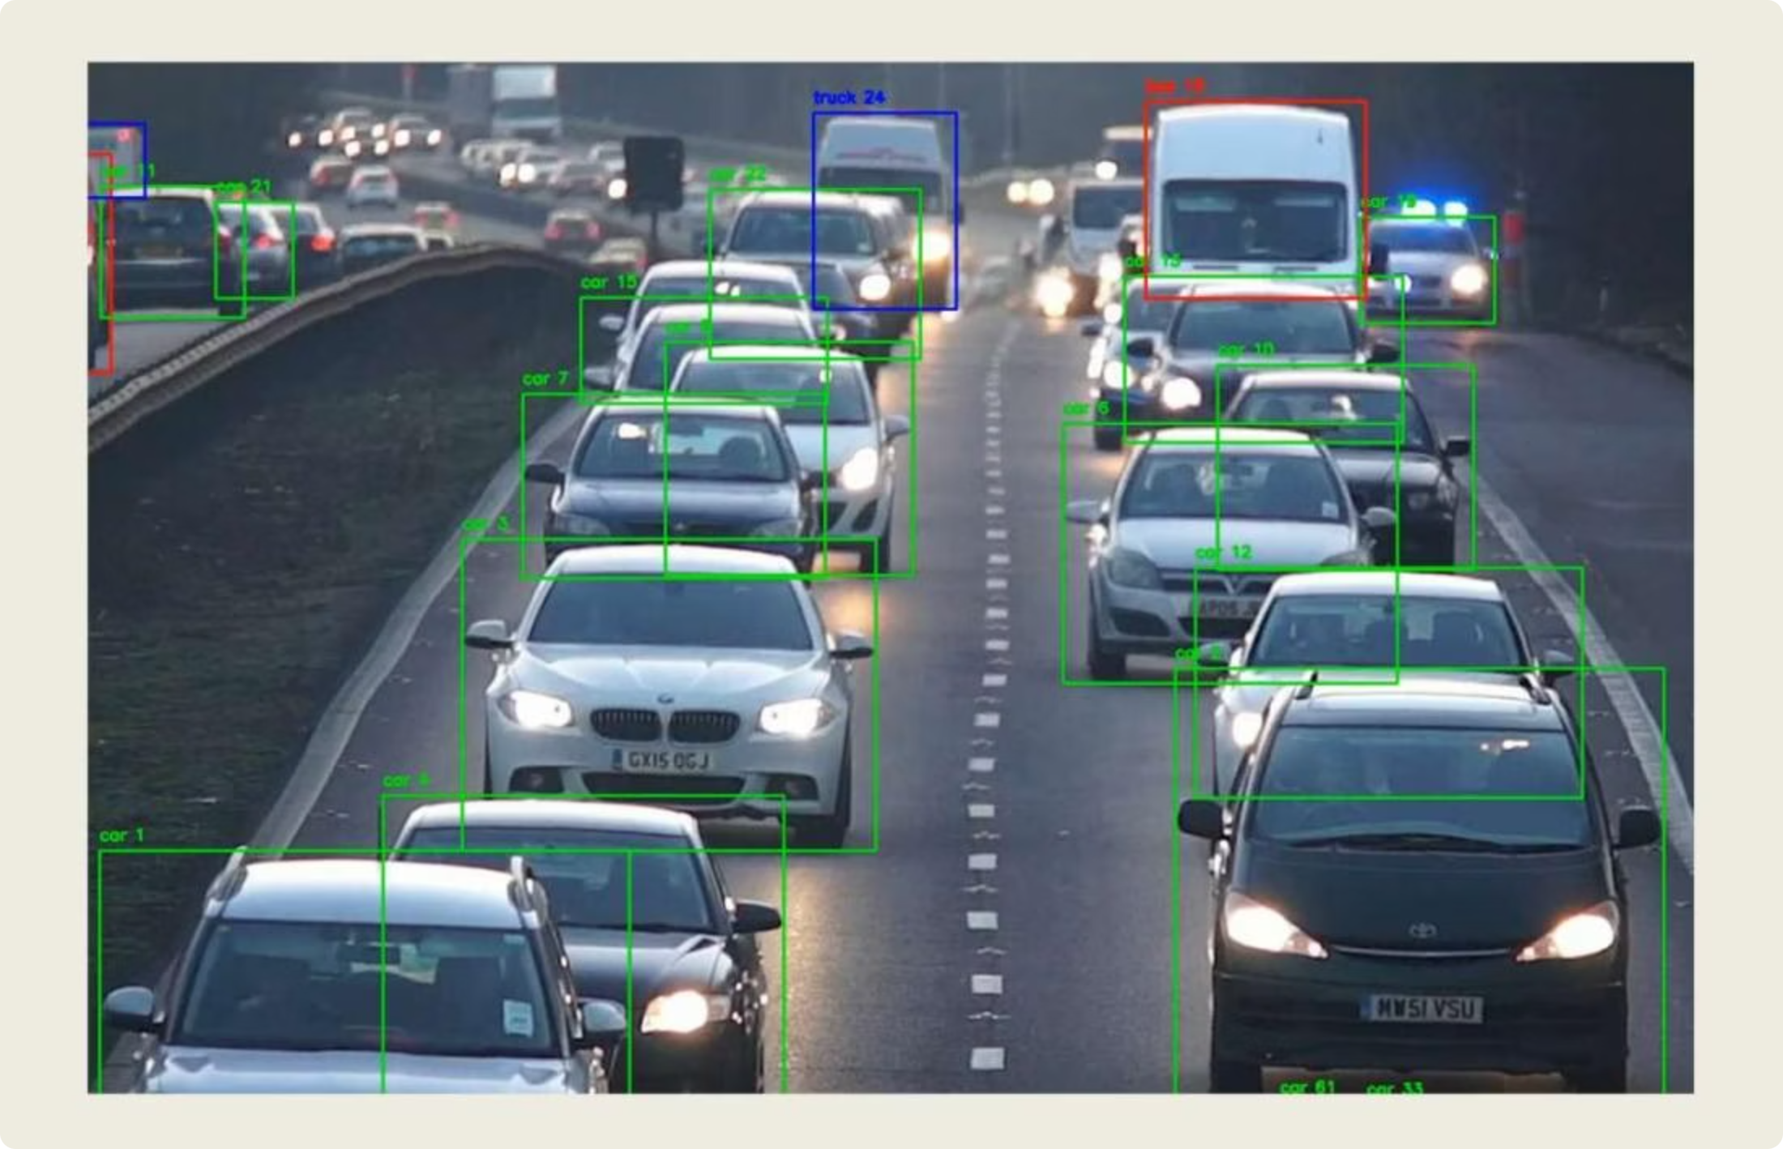
Automated Traffic Classification and Control (ATCC)
Data Collection and Processing
01
02
Video Input and Processing
Data Preprocessing
System processes video frames from traffic cameras, capturing details such as vehicle position, movement, and class.
Raw video data is processed to detect vehicle bounding boxes and license plate regions.
03
Vehicle Detection with YOLO
YOLOv8 is used for real-time vehicle detection, classifying vehicles as cars, buses, motorcycles, and trucks.

Slide 7
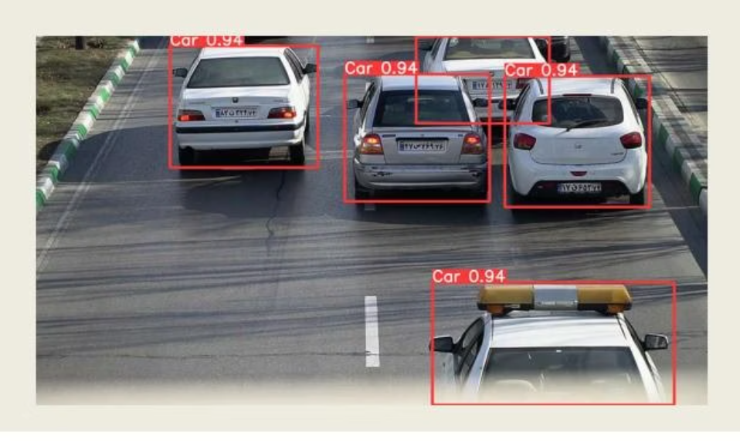
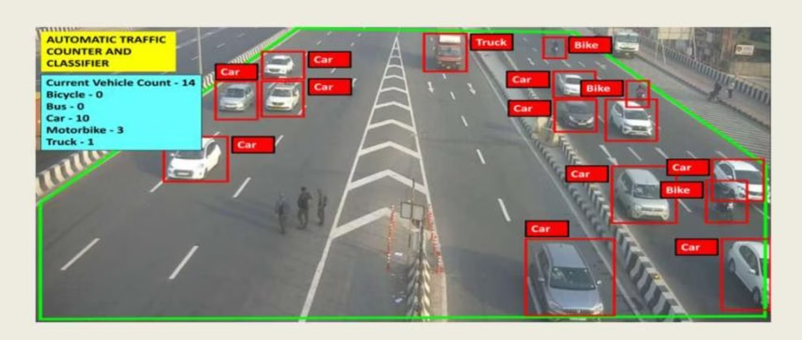
Innovative Technology
Deep Learning Models in Use
ATCC Techniques
1. YOLO (You Only Look Once)
1. Dynamic Traffic Detection
Real-time object detection model
Uses YOLO to identify vehicle types (cars, trucks, buses, etc.)
High accuracy and speed for identifying vehicles and license plates
2. Classification Features
2. Custom License Detection Model
Categorizes vehicles by size, type, and purpose
Tailored for recognizing license plates in varied environmental conditions
Enables intelligent traffic light control and congestion management
Trained on diverse datasets for robustness

Slide 8
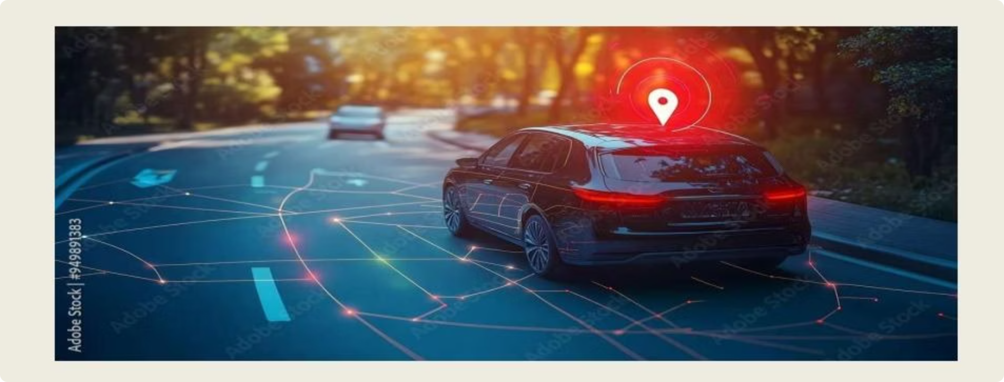

Assigning Number Plates to Vehicles
Detect Vehicles
Detect vehicles using YOLO algorithm
Locate License Plates
Locate license plate regions using custom model
Extract Plate Details
Extract plate details via OCR technology
Vehicle Tracking System
Tracking Mechanism
Combines object detection with motion tracking algorithms
Maintains consistent identification of vehicles across frames
Key Components
Unique ID assignment for each detected vehicle
Trajectory mapping to monitor movement

Slide 9




Future Enhancement
AI and Machine Learning Integration
Edge Computing
AI-driven ANPR systems will adapt to various plate designs, fonts, and languages. ML algorithms will continuously improve recognition accuracy, even in tough conditions.
Edge computing will enable real-time processing and decision-making at the source (e.g., cameras), reducing latency and enabling rapid response in critical applications.
Enhanced Security
Smart Cities & Traffic Management
ANPR will continue to enhance security by identifying vehicles of interest and streamlining access control. Integration with surveillance systems will provide comprehensive security solutions.
ANPR will play a pivotal role in creating smarter, more efficient cities. Deployment of adaptive signals and dynamic signage.

Slide 10

Thank You

